Slide 1
İşletim Sistemleri
DERS 9 BELLEK YONETİMİ I

Slide 2
Bellek Yonetimi
Bellek önemli bir kaynaktır ve dikkatli yönetilmelidir. İşletim sistemlerinde bellek hiyerarşisini yöneten parçaya bellek yöneticisi(memory manager) denilir.
Bellek yöneticisinin görevi, belleğin hangi parçalarının kullanımda olduğunu, hangi parçalarının kullanılmadığını izlemek, süreçlere bellek tahsis etme(allocate) , tahsis edilen belleği geri almak ve belleğin çalışan prosesler için yeterli olmadığı durumlarda bellek ile disk arasındaki takas işlemlerini gerçekleştirmektir.

Slide 3
1. Basit Bellek Yönetimi
Bellek yönetim sistemleri iki temel sınıfda incelenebilir:
Çalışma zamanında süreçleri bellek ile disk arasında yer sürekli yer değiştirenler (takaslama, sayfalama yapanlar). Süreçlerin bu şekilde disk ile bellek arasında yer değiştirilmesinin nedeni, belleğin boyutunun yetersiz olmasıdır.
Değiştirme işlemi yapmayanlar. Bu metod ilkine göre daha basittir.

Slide 4
1. 1 Monoprogramming Without Swapping or Paging
The simplest memory management scheme is to run just one program at a time by sharing the memory between that program and the operating system.
As soon as the user types a command, the operating system copies the requested program from disk to memory and executes it. When the process finishes, the operating system displays a prompt character and waits for a new command. When it receives the command, it loads a new program into memory, overwriting the first one.

Slide 5
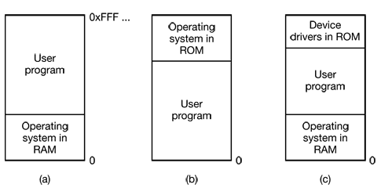

Slide 6
1.2.Multiprogramming with Fixed Partitions
Monoprogramming is only used in simple embedded systems. Most modern systems allow multiple processes to run at the same time.
The easiest way to achieve multiprogramming is simply to divide memory up into n (possibly unequal) partitions. For example, this partitioning can be done manually when the system is started up.
When a job arrives, it can be put into the input queue for the smallest partition large enough to hold it. Since the partitions are fixed in this scheme, any space in a partition not used by a job is lost.

Slide 7
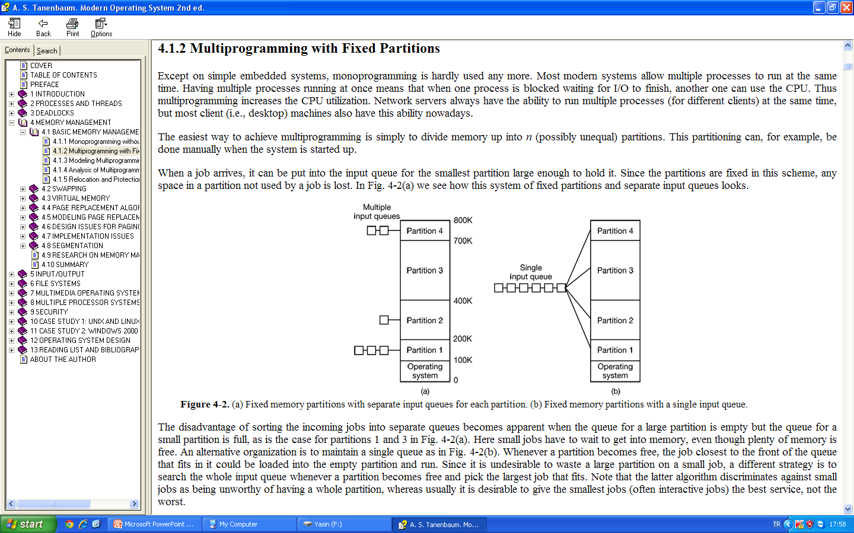
In Fig. (a) we see a fixed partitions with separate input queues. The disadvantage of sorting the incoming jobs into separate queues becomes apparent when the queue for a large partition is empty but the queue for a small partition is full, as in the case for partitions 1 and 3 in Fig. (a). Here small jobs have to wait to get into memory, even though plenty of memory is free.

Slide 8
An alternative organization is to maintain a single queue as in Fig. (b). Whenever a partition becomes free, the job closest to the front of the queue that fits in it could be loaded into the empty partition and run.

Slide 9
1.3. Relocation and Protection
Multiprogramming introduces two essential problems that must be solved—relocation and protection. Different jobs will be run at different addresses. When a program is linked (i.e., the main program, user-written procedures, and library procedures are combined into a single address space), the linker must know at what address the program will begin in memory.

Slide 10
For example, suppose that the first instruction is a call to a procedure at absolute address 100 within the binary file produced by the linker. If this program is loaded in partition 1 (at address 100K), that instruction will jump to absolute address 100, which is inside the operating system. What is needed is a call to 100K + 100. If the program is loaded into partition 2, it must be carried out as a call to 200K + 100, and so on. This problem is known as the relocation problem.
Relocation during loading does not solve the protection problem. There is no way to stop a program from building an instruction that reads or writes any word in memory. In multiuser systems, it is highly undesirable to let processes read and write memory belonging to other users.

Slide 11
An alternative solution to both the relocation and protection problems is to equip the machine with two special hardware registers, called the base and limit registers. When a process is scheduled, the base register is loaded with the address of the start of its partition, and the limit register is loaded with the length of the partition. Every memory address generated automatically by adding the base register contents to it before being sent to memory. Thus if the base register contains the value 100K, a CALL 100 instruction is effectively turned into a CALL 100K+100 instruction. Addresses are also checked with the limit register to make sure that they do not attempt to address outside of the current partition. The memory is protected by the base and limit registers to prevent user programs from modifying them.

Slide 12
2. SWAPPING
With a batch system, organizing memory into fixed partitions is simple and effective. Each job is loaded into a partition when it gets to the head of the queue. It stays in memory until it has finished. As long as enough jobs can be kept in memory to keep the CPU busy all the time, there is no reason to use anything more complicated.
With timesharing systems or graphically oriented personal computers, the situation is different. Sometimes there is not enough main memory to hold all the currently active processes, so excess processes must he kept on disk and brought in to run dynamically.
Two general approaches to memory management can be used: swapping and virtual memory

Slide 13
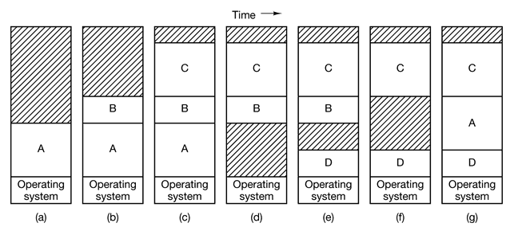
The operation of a swapping system is illustrated in Fig. Initially only process A is in memory. Then processes B and C are created or swapped in from disk. In Fig. (d) A is swapped out to disk. Then D comes in and B goes out. Finally A comes in again.

Slide 14
The number, location, and size of the partitions vary dynamically while processes come and go, whereas they are fixed in the fixed partition method. Memory utilization is improved with the flexibility of not being tied to a fixed number of partitions. So they may be too large or too small, but swapping also complicates allocating and deallocating memory, as well as keeping track of it.
When swapping creates multiple holes in memory, it is possible to combine them all into one big one by moving all the processes downward as far as possible. This technique is known as memory compaction. It is usually not done because it requires a lot of CPU time. For example, on a 256-MB machine that can copy 4 bytes in 40 nsec, it takes about 2.7 sec to compact all of memory.

Slide 15
The allocation is simple, when a process is created with a fixed size that never changes, then the operating system allocates exactly what is needed.
If, however, processes’ data segments can grow, for example, by dynamically allocating memory from a heap, as in many programming languages, a problem occurs whenever a process tries to grow. If a hole is adjacent to the process, it can be allocated and the process allowed to grow into the hole. On the other hand, if the process is adjacent to another process, the growing process will either have to be moved to a hole in memory large enough for it, or one or more processes will have to be swapped out to create a large enough hole. If a process cannot grow in memory and the swap area on the disk is full, the process will have to wait or be killed.

Slide 16
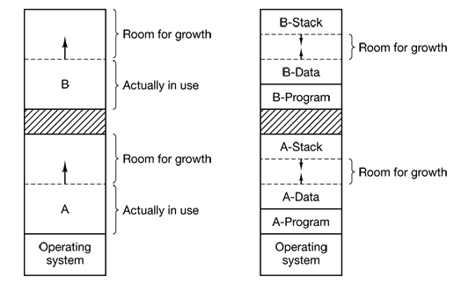
Most processes grow as they run, it is probably a good idea to allocate a little extra memory whenever a process is swapped in or moved, to reduce the overhead of moving or swapping processes. When swapping processes to disk, only the memory actually in use should be swapped: it is wasteful to swap the extra memory as well.

Slide 17
2.1. Memory Management with Bitmaps
When memory is assigned dynamically, the operating system must manage it. In general terms, there are two ways to keep track of memory usage: bitmaps and free lists.
With a bitmap, memory is divided up into allocation units, perhaps as small as a few words and perhaps as large as several kilobytes. Corresponding to each allocation unit is a bit in the bitmap. If it is 0, the unit is free and if it is 1 it is occupied (not empty).

Slide 18
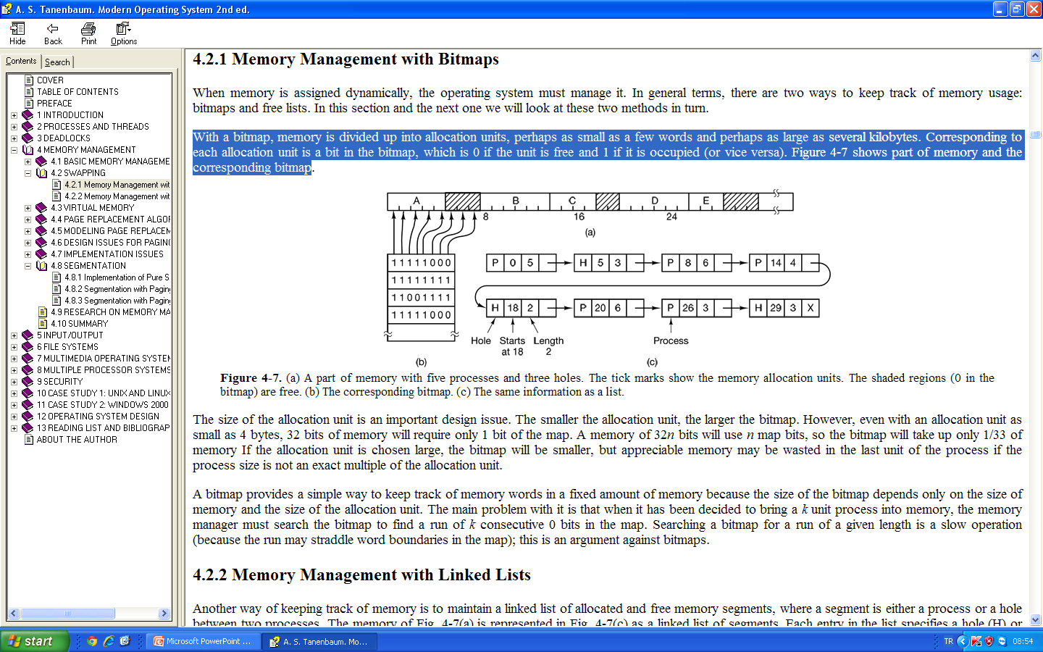
(a) A part of memory with five processes and three holes. The tick marks show the memory allocation units. The shaded regions (0 in the bitmap) are free. (b) The corresponding bitmap.
The size of the allocation unit is an important design issue.

Slide 19
2.2 Memory Management with Linked Lists
Another way of keeping track of memory is to maintain a linked list of allocated and free memory segments, where a segment is either a process or a hole between two processes. Each entry in the list specifies a hole (H) or process (P), the address at which it starts, the length, and a pointer to the next entry.

Slide 20
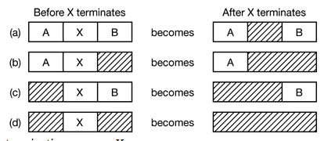
In this example, the segment list is kept sorted by address. Sorting this way has the advantage that when a process terminates or is swapped out, updating the list is straightforward. A terminating process normally has two neighbors. These may be either processes or holes, leading to the four combinations.

Slide 21
When the processes and holes are kept on a list sorted by address, several algorithms can be used to allocate memory for a newly created process (or an existing process being swapped in from disk):
The simplest algorithm is first fit. The memory manager scans along the list of segments until it finds a hole that is big enough. The hole is then broken up into two pieces, one for the process and one for the unused memory, First fit is a fast algorithm because it searches as little as possible.

Slide 22
A minor variation of first fit is next fit. It works the same way as first fit, except that it keeps track of where it is whenever it finds a suitable hole. The next time it is called to find a hole, it starts searching the list from the place where it left off last time, instead of always at the beginning, as first fit does. Simulations show that next fit gives slightly worse performance than first fit.
Another well-known algorithm is best fit. Best fit searches the entire list and takes the smallest hole that is appropriate. Rather than breaking up a big hole that might be needed later, best fit tries to find a hole that is close to the actual size needed. Best fit is slower than first fit because it must search the entire list every time it is called.

Slide 23
3. VIRTUAL MEMORY
The basic idea behind virtual memory is that the combined size of the program, data, and stack may exceed the amount of physical memory available for it. The operating system keeps those parts of the program currently in use in main memory, and the rest on the disk. For example, a 16-MB program can run on a 4-MB machine by carefully choosing which 4 MB to keep in memory at each instant, with pieces of the program being swapped between disk and memory as needed.
Virtual memory can also work in a multiprogramming system. While a program is waiting for part of itself to be brought in, it is waiting for I/O and cannot run, so the CPU can be given to another process, the same way as in any other multiprogramming system.

Slide 24
3.1. Paging
Most virtual memory systems use a technique called paging.
On any computer, there exists a set of memory addresses that programs can produce.When a program uses an instruction like
MOV REG,1000
it does this to copy the contents of memory address 1000 to REG (or vice versa). Addresses can be generated using indexing, base registers, segment registers, and other ways.

Slide 25
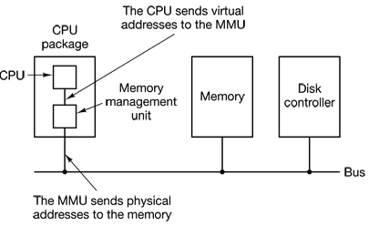
These program-generated addresses are called virtual addresses and form the virtual address space. When virtual memory is used, the virtual addresses do not go directly to the memory bus. Instead, they go to an MMU (Memory Management Unit) that maps the virtual addresses onto the physical memory addresses as illustrated in Fig.

Slide 26
Let’s suppose, we have a computer that can generate 16-bit addresses, from 0 up to 64K. These are the virtual addresses. This computer, however, has only 32 KB of physical memory, so although 64-KB programs can be written, they cannot be loaded into memory in their entirety and run. A complete copy of a program’s core image must be present on the disk so that pieces can be brought in as needed.
The virtual address space is divided into units called pages. The corresponding units in the physical memory are called page frames. The pages and page frames are always the same size. In this example they are 4 KB. With 64 KB of virtual address space and 32 KB of physical memory, we get 16 virtual pages and 8 page frames. Transfers between RAM and disk are always in units of a page.

Slide 27
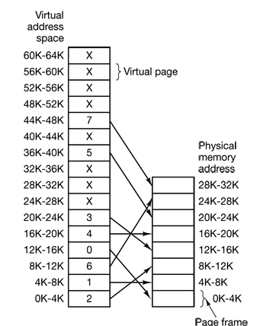
When the program tries to access address 0, for example, using the instruction
MOV REG,0
virtual address 0 is sent to the MMU. The MMU sees that this virtual address falls in page 0 (0 to 4095), which according to its mapping is page frame 2 (8192 to 12287). It thus transforms the address to 8192 and outputs address 8192 onto the bus. The memory knows nothing at all about the MMU and just sees a request for reading or writing address 8192. Thus, the MMU has effectively mapped all virtual addresses between 0 and 4095 onto physical addresses 8192 to 12287.

Slide 28
Since we have only 8 physical page frames and 16 virtual page, only eight of the virtual pages in Fig. are mapped onto physical memory. The others, shown as a cross in the figure, are not mapped. In the actual hardware, a Present/absent bit keeps track of which pages are physically present in memory.

Slide 29
What happens if the program tries to use an unmapped page, for example, by using the instruction
MOV REG,32780
which is byte 12 within virtual page 8 (starting at 32768)? The MMU notices that the page is unmapped and causes the CPU to trap to the operating system. This trap is called a page fault. The operating system picks a little-used page frame and writes its contents back to the disk. It then fetches the page just referenced into the page frame just freed, changes the map, and restarts the trapped instruction.

Slide 30
Page Tables
The virtual address is split into a virtual page number (high-order bits) and an offset (low-order bits). For example, with a 16-bit address and a 4-KB page size, the upper 4 bits could specify one of the 16 virtual pages and the lower 12 bits would then specify the byte offset (0 to 4095) within the selected page. However a split with 3 or 5 or some other number of bits for the page is also possible. Different splits imply different page sizes.

Slide 31
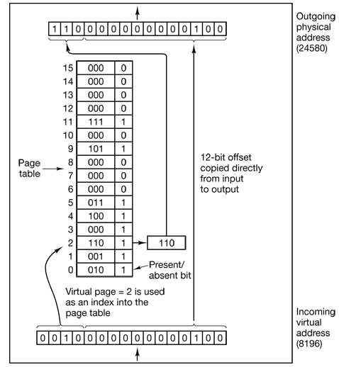
The virtual page number is used as an index into the page table to find the entry for that virtual page.
The purpose of the page table is to map virtual pages onto page frames. Mathematically speaking, the page table is a function, with the virtual page number as argument and the physical frame number as result.

Slide 32
With a 4-KB page size, a 32-bit address space has 1 million pages, and a 64-bit address space has more than you can imagine. With 1 million pages in the virtual address space, the page table must have 1 million entries. And remember that each process needs its own page table (because it has its own virtual address space).

Slide 33
Multilevel Page Tables
Because of huge page tables in memory all the time, many computers use a multilevel page table. A simple example, we have a 32-bit virtual address that is partitioned into a 10-bit PT1 field, a 10-bit PT2 field, and a 12-bit Offset field. Since offsets are 12 bits, pages are 4 KB. and there are a total of 2²⁰ of them.

Slide 34
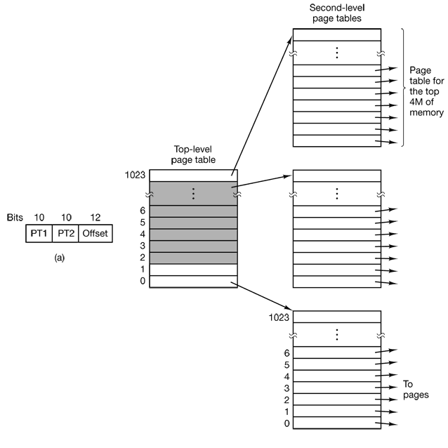
The secret to the multilevel page table method is to avoid keeping all the page tables in memory all the time.
The two-level page table system can be expanded to three, four, or more levels. Additional levels give more flexibility, but it is doubtful that the additional complexity is worth it beyond three levels.

Slide 35
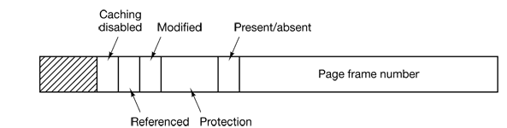
Structure of a Page Table Entry
The size varies from computer to computer, but 32 bits is a common size. The most important field is the Page frame number. Next to it we have the Present/absent bit. If this bit is 1, the entry is valid and can be used. Accessing a page table entry with this bit set to 0 causes a page fault.

Slide 36
The Protection bits tell what kinds of access are permitted. In the simplest form, this field contains 1 bit, with 0 for read/write and 1 for read only.
The Modified and Referenced bits keep track of page usage. When a page is written to, the hardware automatically sets the Modified bit. If the page in it has been modified (i.e., is “dirty”), it must be written back to the disk. If it has not been modified, it can just be abandoned, since the disk copy is still valid. The bit is sometimes called the dirty bit.
The Referenced bit is set whenever a page is referenced, either for reading or writing.
With Caching Disabled bit, caching can be turned off. Machines that have a separate I/O space and do not use memory mapped I/O do not need this bit.
Note that the disk address used to hold the page when it is not in memory is not part of the page table. The reason is simple. The page table holds only that information the hardware needs to translate a virtual address to a physical address. Information the operating system needs to handle page faults is kept in software tables inside the operating system.

Slide 37
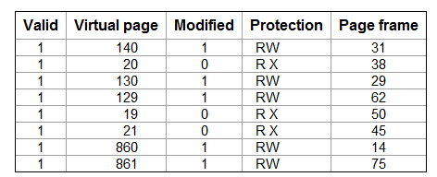
TLBs—Translation Lookaside Buffers
TLB is small hardware device for mapping virtual addresses to physical addresses without going through the page table and TLB is sometimes called associative memory.

Slide 38
When a virtual address is presented to the MMU for translation, the hardware first checks to see if its virtual page number is present in the TLB by comparing it to all the entries simultaneously. If a valid match is found and the access does not violate the protection bits, the page frame is taken directly from the TLB, without going to the page table.
The interesting case is what happens when the virtual page number is not in the TLB, The MMU detects the miss and does an ordinary page table lookup. It then evicts one of the entries from the TLB and replaces it with the page table entry just looked up.

Slide 39
QUESTIONS?

